Slide 1

Deep Learning Module 4 project Predicting Breast Cancer
LaShanni Butler
Flatiron School
7/26/19

Slide 2

Agenda
Overview
Background
Problem Statement
Machine & Deep Learning models
Conclusion
Recommendations & Future work

Slide 3
Overview
What is Deep Learning?
It’s a machine learning technique that teaches computers to do what comes naturally to humans: learn by example
In deep learning, a computer model learns to perform classification or regression tasks directly from images, text, or sound
These models can achieve state-of-the-art accuracy
Examples include:
Driverless cars
Voice control technology in devices (like Siri)
Cancer detection
Sources: https://www.mathworks.com/discovery/deep-learning.html

Slide 4
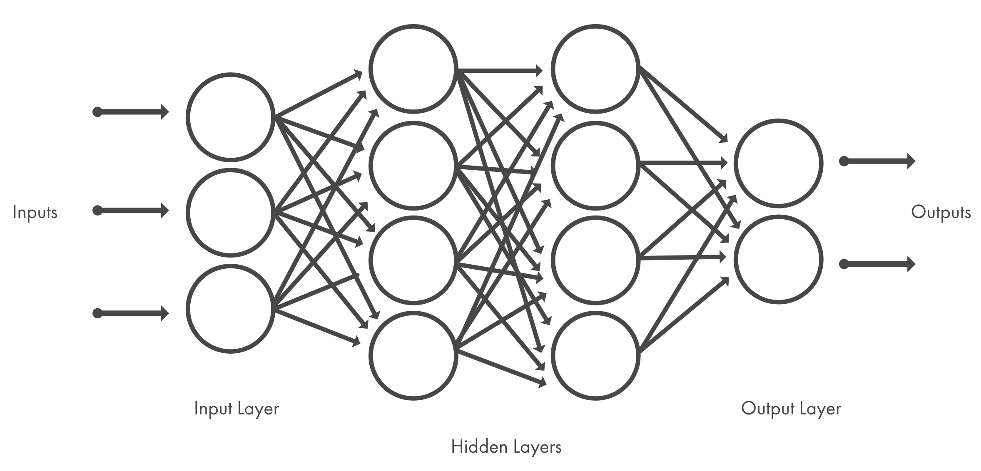
Background
How Deep Learning Works:
Deep learning methods use neural network, which resembles the structure (or neurons) of the human brain
The structures are connected by nodes
The data passes through the nodes in each layer
ources: https://www.mathworks.com/discovery/neural-network.html
Notes:
Within supervised learning, there are 2 types: Classification (which we’ll focus on) and Regression.
Classification is the type of Supervised Learning in which labelled data can use, and this data is used to make predictions in a non-continuous form. The output of the information is not always continuous, and the graph is non-linear. In the classification technique, the algorithm learns from the data input given to it and then uses this learning to classify new observation.

Slide 5

Problem Statement
The dataset: Breast cancer data obtained from University of California, Irvine. The data contains 569 patient samples and was stained to determine if the patient had cancer (i.e. - malignant) or no cancer (i.e. – benign)
The Ask: With the dataset provided, can we use a deep learning model to accurately predict breast cancer?
Sources:
Kaggle dataset: https://www.kaggle.com/uciml/breast-cancer-wisconsin-data

Slide 6
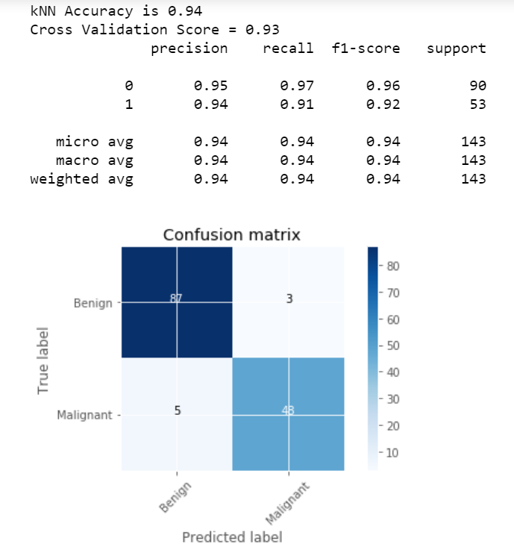
K-Nearest Neighbors
KNN is generally used to predict categorical values based on the nearest datapoints of interests
Confusion matrix: a summary of prediction results on a classification problem. The number of correct and incorrect predictions are summarized with count values and broken down by each class.
Notes:
KNN algorithm is one of the most straightforward algorithms in classification, and it is one of the most used learning algorithms. A majority vote of an object is classified by its neighbors, with the purpose being assigned to the class most common among its k nearest neighbors.

Slide 7
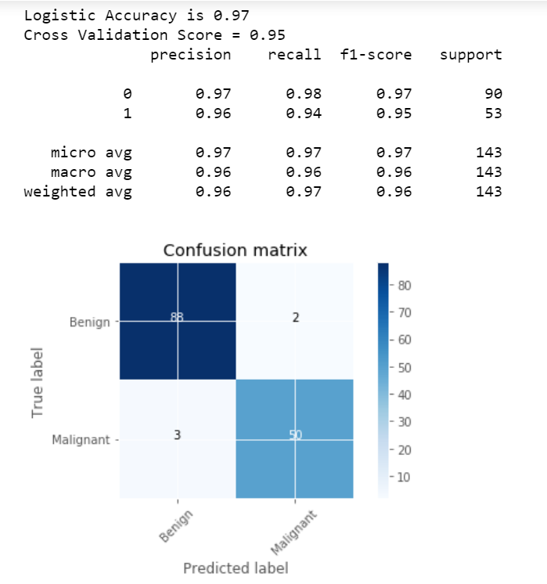
Logistic Regression
The simplest classification algorithm used for binary or multiclassification problems (datasets where y = 0 or 1, where 1 denotes the default class).
Notes:
Logistic regression predictions are discrete values (whether a student passed/failed) after applying a transformation function.
Logistic regression is best suited for binary classification (datasets where y = 0 or 1, where 1 denotes the default class).
Example: In predicting whether an event will occur or not, the event that it occurs is classified as 1. In predicting whether a person will be sick or not, the sick instances are denoted as 1). It is named after the transformation function used in it, called the logistic function h(x)= 1/ (1 + e^x), which is an S-shaped curve.

Slide 8
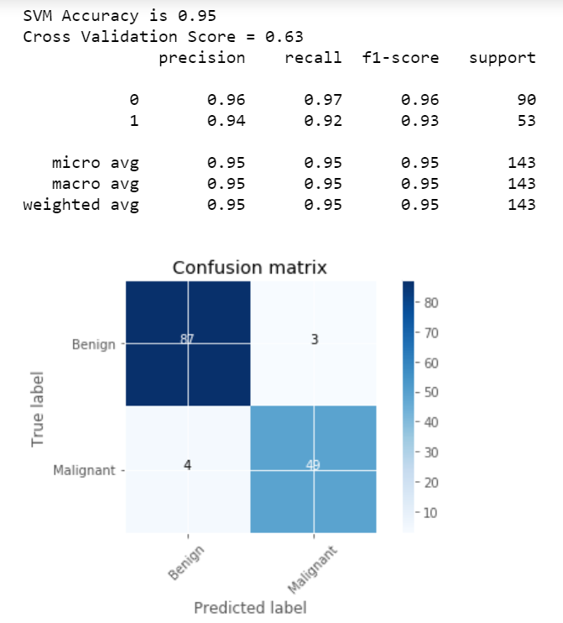
Support Vector Machine (SVM)
Is widely used classification algorithm. SVM creates a separation line which divides the classes in the best possible manner. Ex - dog or cat, disease or no disease.
Notes:
A Support Vector Machine is a type of Classifier, in which a discriminative classifier formally defined by a separating hyperplane. The algorithm outputs an optimal hyperplane which categorizes new examples. In two dimensional space, this hyperplane is a line dividing a plane into two parts wherein each class lay on either side.

Slide 9
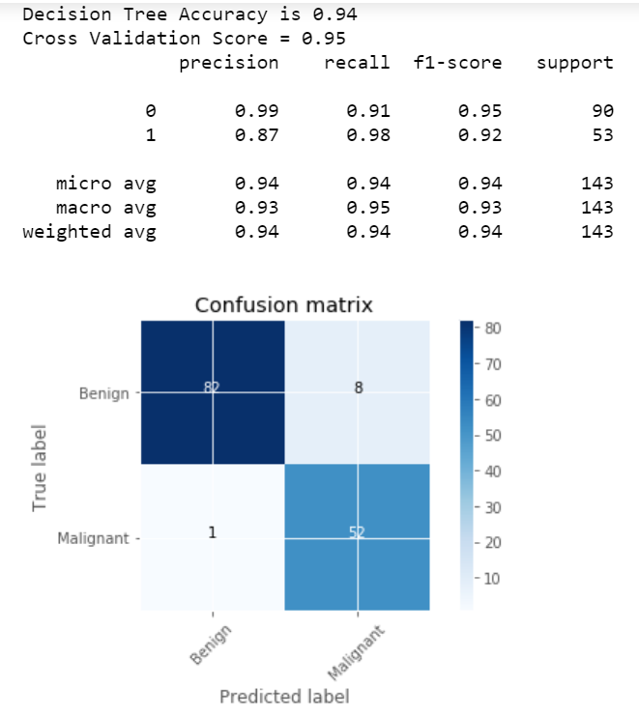
Decision Tree
Is an inverted tree shaped algorithm used to determine a course of action. Each tree branch represents a possible decision
Notes:
Decision tree makes classification models in the form of a tree structure. An associated decision tree incrementally developed and at the same time It breaks down a large data-set into smaller subsets. The final result is a tree with decision nodes and leaf nodes. A decision node (e.g., Root) has two or more branches. Leaf node represents a classification or decision. The first decision node in a tree which corresponds to the best predictor called root node. Decision trees can handle both categorical and numerical data.

Slide 10
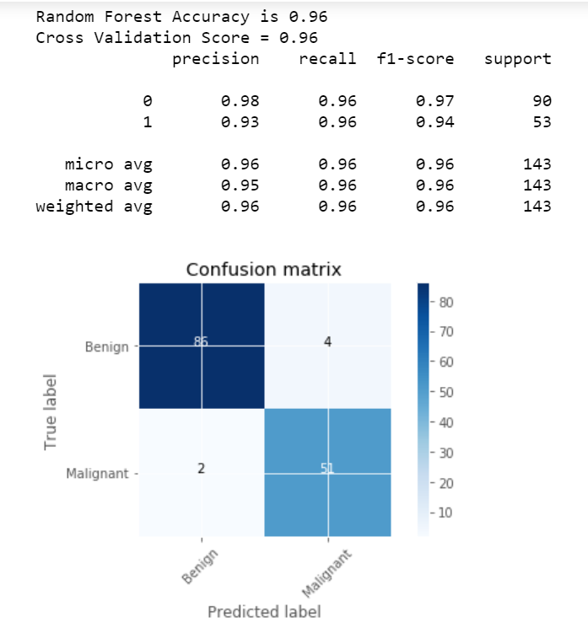
Random Forest
Similar to Decision Tree, but multiple trees are used. Each "tree" observation is classified. Usually increased the accuracy when DT is used as an algorithm.
Notes:
Random Forest is a supervised learning algorithm. It creates a forest and makes it somehow casual. The wood it builds is an ensemble of Decision Trees, it most of the time the decision tree algorithm trained with the “bagging” method, which is a combination of learning models increases the overall result.

Slide 11
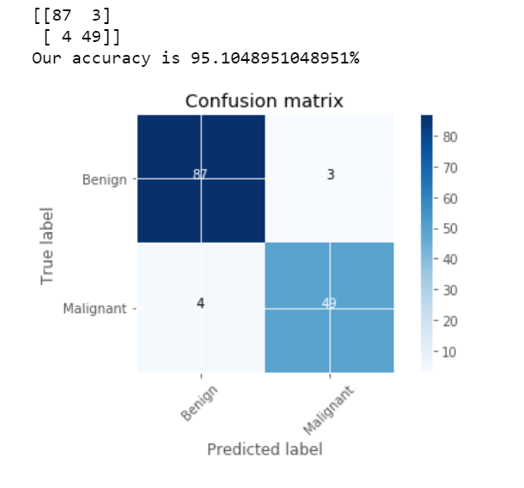
Keras (Deep learning)
Keras is a high-level neural networks focused on enabling fast experimentation.

Slide 12
Conclusions
Logistic regression had the highest level of accuracy (97%) in predicting malignancy
Random Forest and Keras came in second (96%) in accurately predicting malignancy
This methodology could help reduce physician burnout and speed up detection
Accurate detection can reduce the likelihood of a missed diagnosis by a human eye
Conversely, this methodology isn’t perfect. A physician will still have to double check positive results

Slide 13
Recommendations& Future work
Use Logistic regression for detection, and improve parameters in Keras deep learning model to improve accuracy
Possibly adjust training and testing set of data to see if that will yield higher accuracy
Add more features to the dataset, making it more robust for testing
Explore other deep learning models to determine level of accuracy

Slide 14
Thank You!
Questions/Concerns/Comments?
Video walkthrough link: https://drive.google.com/file/d/1NnPp9B_FS0n04dNrlY3mxoV7BN3hhd_l/view?usp=sharing

